Slide 1

HULT Prize
introduct
Theme: Food for Goods
unit
solution
problems
1million
farmers
team
Team “Hult Units”

Slide 2

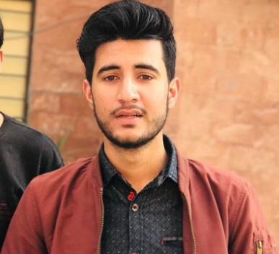
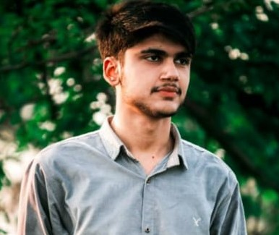
Team Captain:
Muhammad Shaf Hameed
unit
problems
introduct
Solution
farmers
Team
1million
Team Member1:
Muhammad Fayyaz
Team Member2:
Sikander Shah

Slide 3
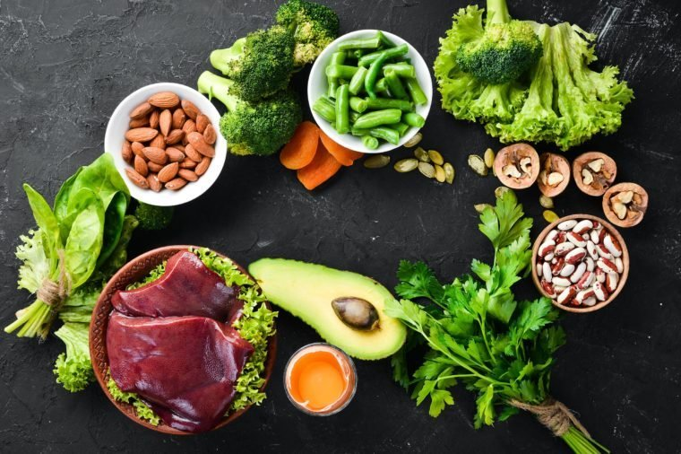
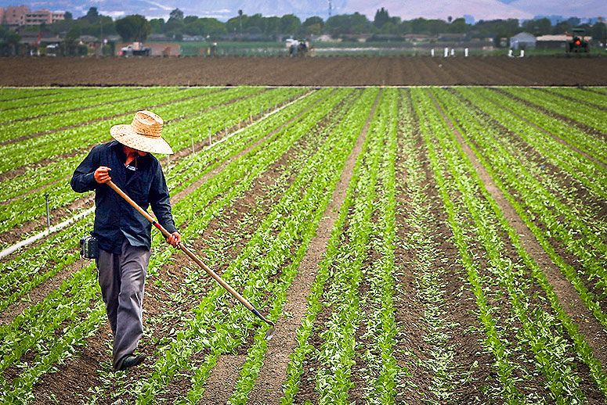
unit
Introduct
solution
problems
1million
farmers
team

Slide 4
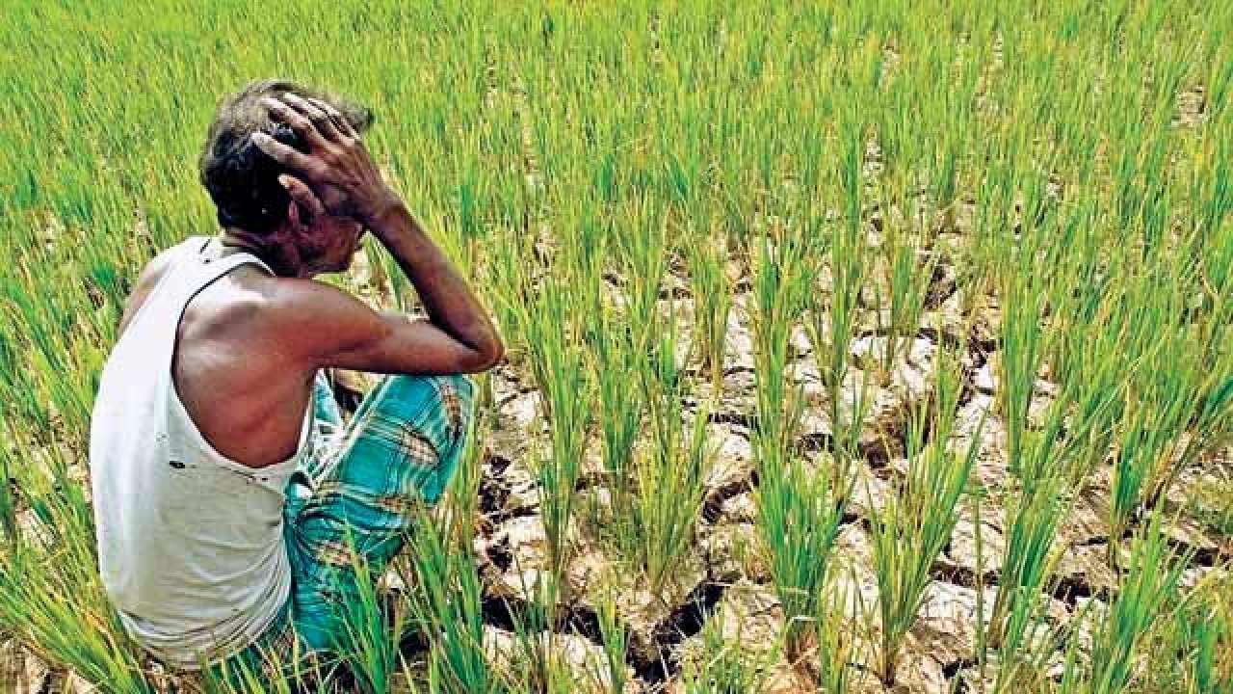
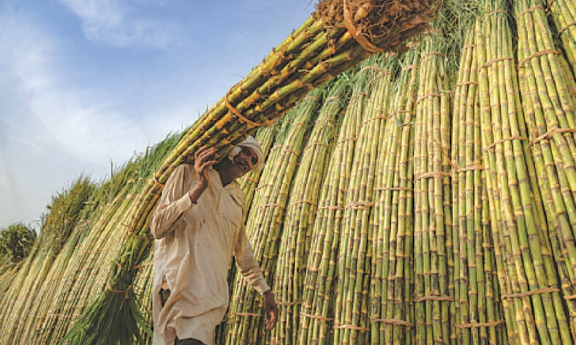
unit
introduct
solution
1million
problems
farmers
team

Slide 5



unit
introduct
Revenue
solution
farmers
team
EXPAND
problems
1million
Problem:1
Lack of Facilities
Problem:2
GUIDNESS
Problem:3
The Gap

Slide 6



unit
Solution
introduct
problems
Revenue
framers
team
EXPAND
1million
Institute
Selling Product
Hult Unit

Slide 7





Technology
unit
intoduct
1million
Solution
problems
Revenue
Guidness
farmers
teams
EXPAND
Imported Seeds
Free courses
Services
Land of owners
e.t.c
Employement

Slide 8
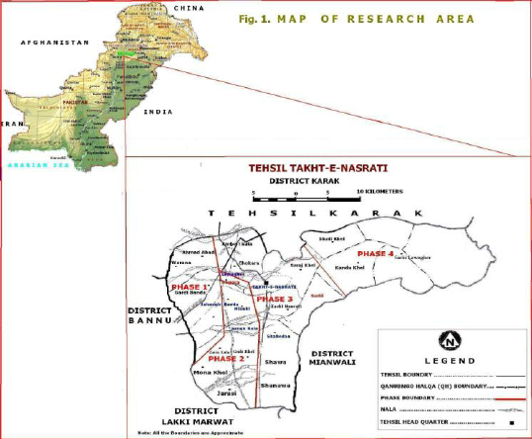

160,100,000.00 Pakistani Rupee
Land | 20-30 lac
Building | 1.2 coror
Others | 50 lac
Total | 2 coror
50,100,000
1million
Solution
history
teams
timeline
Revenue
unit
about
EXPAND
1million
Employes and Products
Labour Force | 3 coror
Product | 6 coror
Total | 9 corror

Slide 9
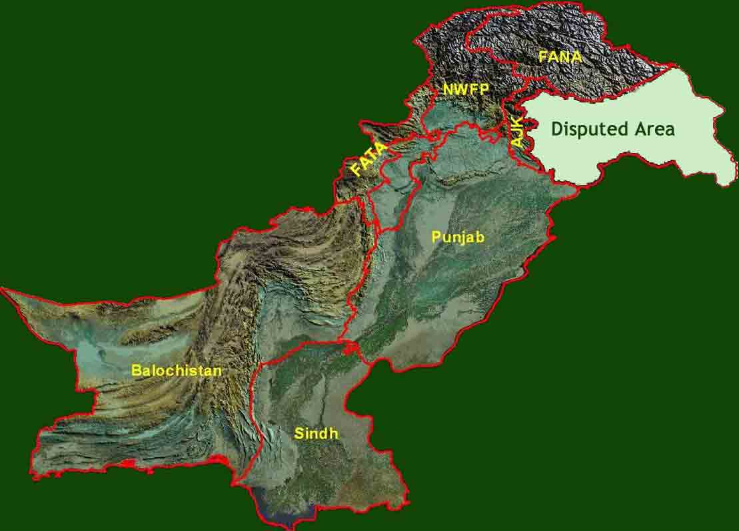
2030
Technology
Products
Servicess
Land of owners |  | 50%
Industry and mills
Total
1million
history
Expand
Solution
teams
timeline
unit
about
1million
Revenue

Slide 10

2030
2029
2028
NETWORK
2027
2026
2025
2024
history
Expand
1million
Solution
teams
timeline
unit
about
1million
Expand
2023
Revenue
2022
2021
food
Employement
GDP

